Slide 1
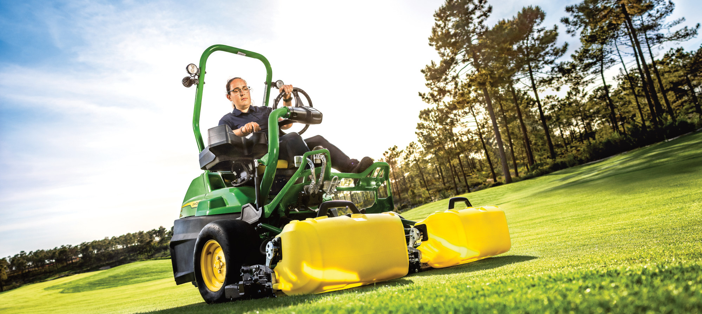
Automatic Grass Catcher Cleanout
NCSU Capstone Senior Design Project

Slide 2
Agenda
Capstone Project: Automated Grass Catcher Cleanout
 | Presenter Introductions | Jeremy, Keir, Chris, Joe, John
 | John Deere Overview | Joe
 | Introduction to Turf Care Fuquay Varina NC | Jeremy
 | Project Overview | Keir, Chris and Team

Slide 3
Presenters
Jeremy Lambert
Project Engineer – Golf
BSME 2004, MSME 2006, MBA 2011 NCSU
18 Years with Deere
lambertjeremyb@johndeere.com
Joseph Meyers
Product Engineer – Compact Utility Tractors
BSME 2019 NCSU
7 Years with Deere
MeyersJosephE@JohnDeere.com
Christopher Carnes
Product Engineer – Commercial Mowing
BSME 2018 NCSU
5 Years with Deere
carneschristopher@johndeere.com
Keir Jenkins
Product Engineer – SL2 Test Lead
BS BAET '21 NCSU
5 Years with Deere
JenkinsKeirT@johndeere.com

Slide 4
Presenters
John Hill
Product Engineer – Golf
BSME 2023 NCSU
4 Years with Deere
hilljohnm@johndeere.com
Brandon Thomas
Product Specialist– Commercial Mowing
BSME 2023, MBA 2024-Now NCSU
4 Years with Deere
ThomasBrandonB@johndeere.com

Slide 5
OUR PURPOSE
WE RUN SO LIFE CAN LEAP FORWARD
Notes:
The purpose of John Deere
John Deere is …
the world's leading manufacturer of agricultural machinery and one of the leading suppliers of machines for construction, forestry and turf
committed to the success of customers whose work is linked to the land - those who cultivate, harvest, transform, enrich and build upon the land to meet the world’s dramatically increasing need for food, fuel, shelter and infrastructure
Since 1837, John Deere has gradually developed to become the world‘s largest manufacturer of agricultural equipment, as well as a leading supplier of lawn and grounds care equipment and of construction and forestry equipment

Slide 6
OUR BASELINE
Integrity
Quality
Humanity
Engagement
Innovation
Notes:
John Deere always stands up for those connected to the land - crop and livestock farmers, landowners and contractors.
John Deere has never outgrown its founder's original core values and has never forgotten them: Integrity, quality, humanity, engagement and innovation.
These values guide the path we take, the quality we offer and the unparalleled way we treat our customers, investors and employees.
Integrity
John Deere prioritised trust, even in the early days of his company.
His vision was that his customers would always be able to trust the products that bear his name.
That is still true today: from the smallest spare part to the largest combine harvester.
It also means treating everyone with fairness and respect.
Quality
Since 1837, John Deere has not forgotten this.
In the beginning, John Deere imported steel from England because American steel did not meet its high standards.
In the 1940s, we were the first to introduce statistical processes for continuous quality.
Since 1992, all John Deere units have been ISO 9000 quality certified.
Behind our reliability is a deeply embedded quality control system that has been refined for over 180 years.
Humanity:
Bringing people together.
Fostering inclusivity.
Making us an even more awsome squad.
Engagement
Integrity involves a large part of commitment
We are there for you if you need us. On time, every time. We know our customers' world doesn't close when other people go home.
It also means that we are committed to those around us
Since 1984, the John Deere Foundation has invested tens of millions of dollars in educational, developmental and cultural programs. Since 2005, the foundation has also been committed to fighting world hunger.
Innnovation
From the first self-cleaning steel plough to today's innovations
Saving money and increasing productivity - that's what we call innovation.

Slide 7

JOHN DEERE SOLUTIONS
PORTFOLIO
Agricultural Equipment
Construction Equipment
Turf Equipment
Forestry Equipment
Financial Services
Power Systems
Intelligent Solutions
Worldwide Parts Services
Notes:
The John Deere Strategy: an integrated company
We will operate a portfolio of interrelated businesses, each with a vital and specific role in helping the enterprise meet its
performance goals and fulfil its purpose.
John Deere’s agricultural and construction equipment operations – both global growth businesses – help our customers address the requirements of a growing, more affluent population.
Turf and forestry equipment businesses serve customers with innovative, high-quality products and strengthen the channel development of our global growth operations.
Other businesses – Financial Services, Power Systems, Intelligent Solutions Group and Worldwide Parts Services – strengthen and further differentiate the Agricultural, Construction, Turf and Forestry Equipment businesses, and focus on activities critical to the equipment operations’ success.
Each business works to extend the unique John Deere Experience to customers throughout the world by the seamless integration of products and services, which creates greater value than any alternative provided in the marketplace.
By leveraging our strengths as an integrated enterprise, we are strongly positioned to deliver high levels of value to customers while generating superior returns for our shareholders and employees

Slide 8


More than 100 Locations.
76 manufacturing locations in 16 countries
GLOBAL FOOTPRINT
MANUFACTURING FACILITIES
As of 31. October 2024
Notes:
John Deere operates worldwide.
76 manufacturing locations in 16 countries
Other locations in over 30 countries (sales, marketing, parts centres)
Nearly 76,000 employees
JD products are sold in more than 160 countries.

Slide 9
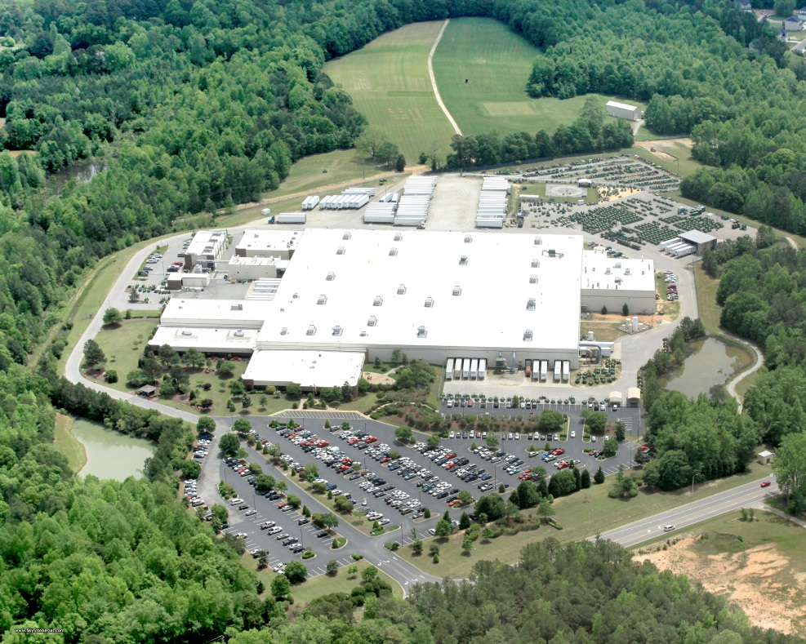
John Deere Turf Care
Fuquay-Varina, NC
Facilities = 335,325 Sq. Ft. existing Manufacturing: 278,000 Sq. Ft.
Office Areas: 36,000 Sq. Ft.
Engineering Labs: 21,325 Sq. Ft.
Site: 106 acres (mowing: 49 acres)
Notes:
Our Benson Warehouse is used to store both raw materials (parts and components) and finished goods. It’s located about 27 miles from our facility and takes about 30 – 45 minutes to travel to and from Turf Care. We have shuttles running every hour either delivering parts or picking up new finished product. The Benson warehouse is conveniently located for both ground and rail transportation to ship our equipment to the dealer market.
Cary office
Has engineering, software development, marketing
Supports TC and other factories within our division

Slide 10
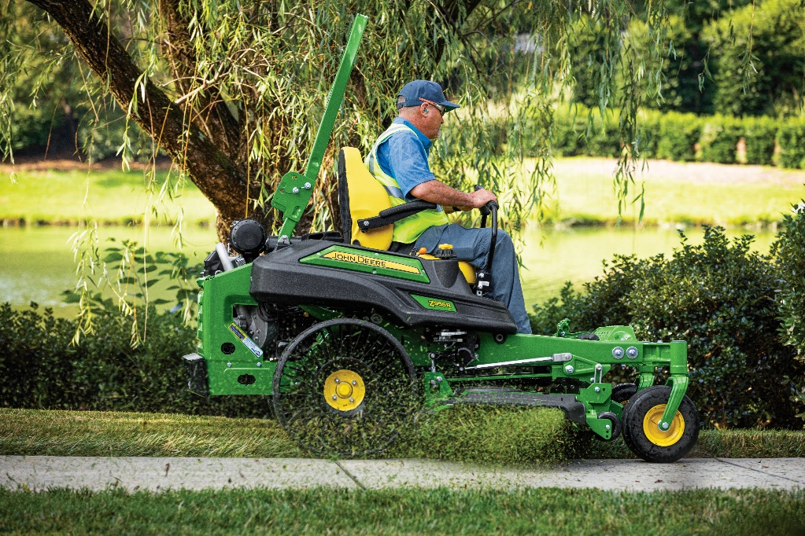
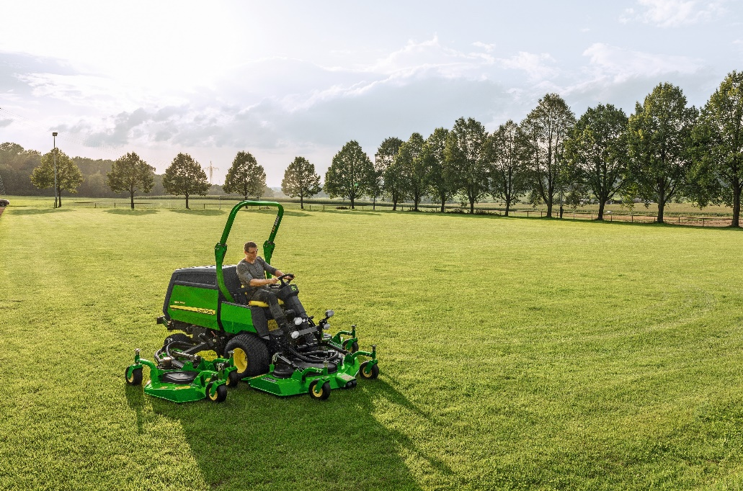
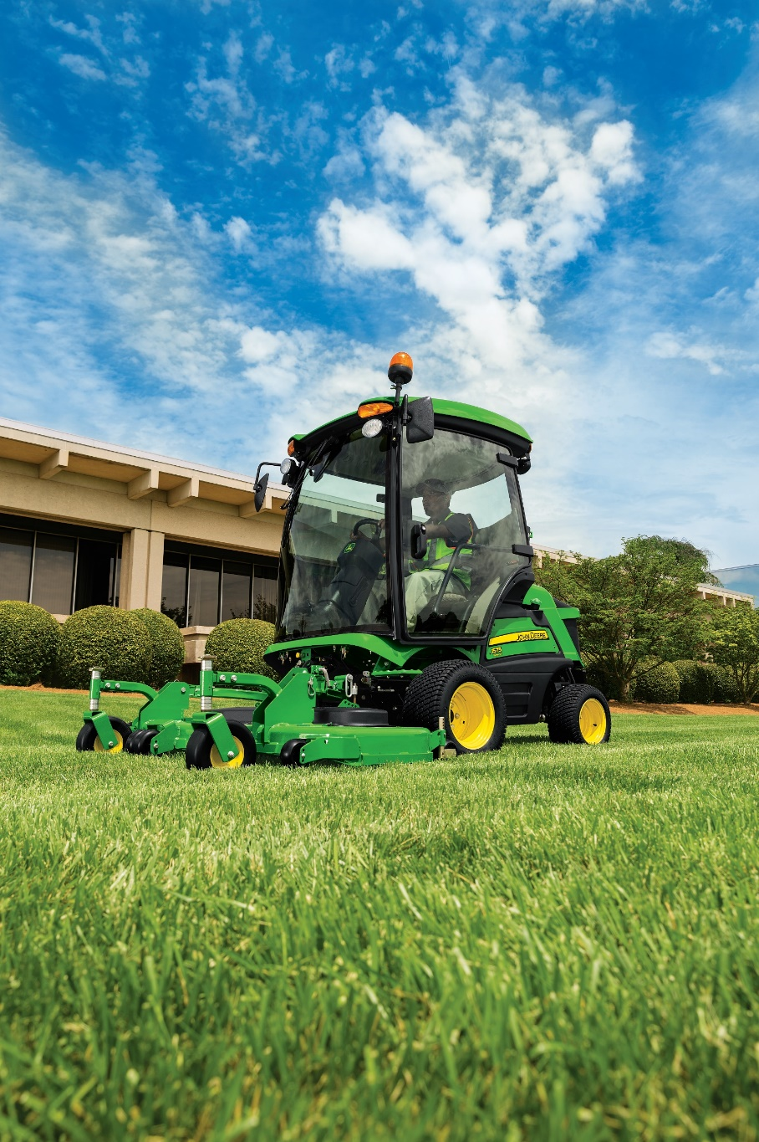
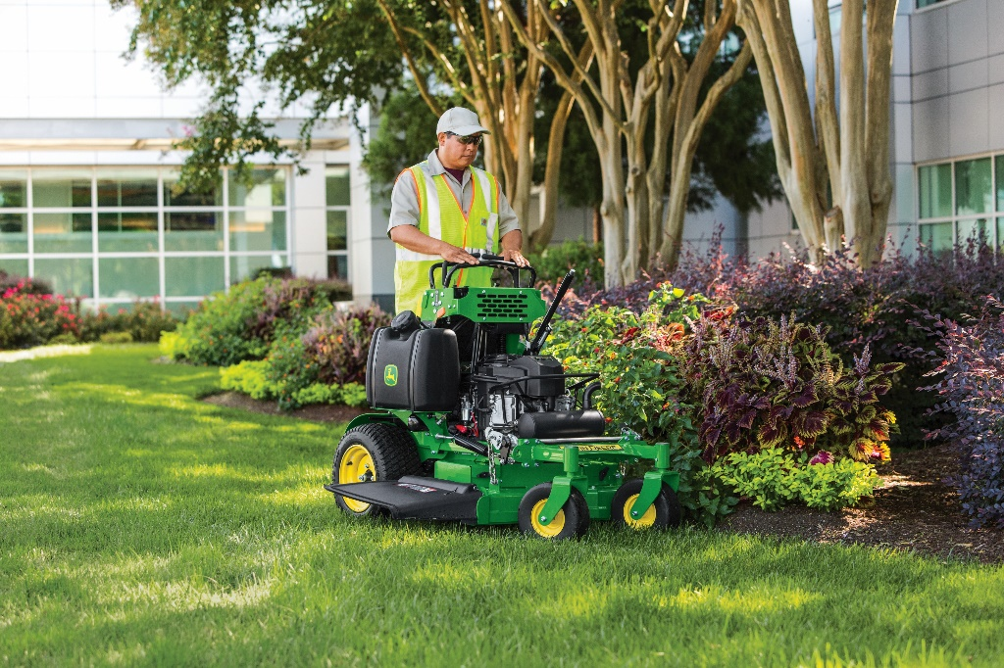
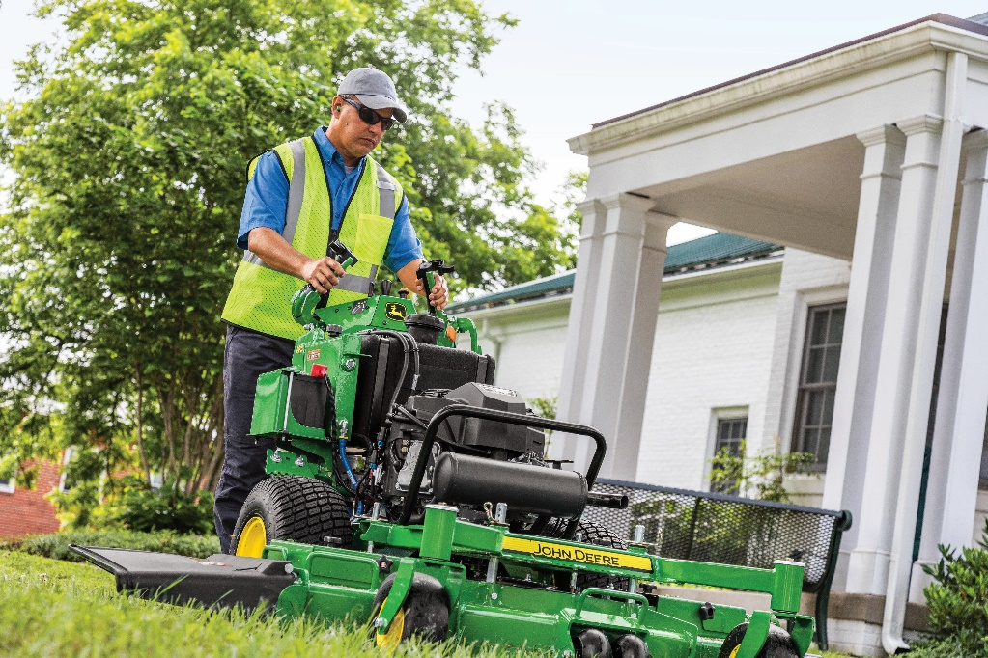
John Deere Turf Care
Commercial Mowing

Slide 11

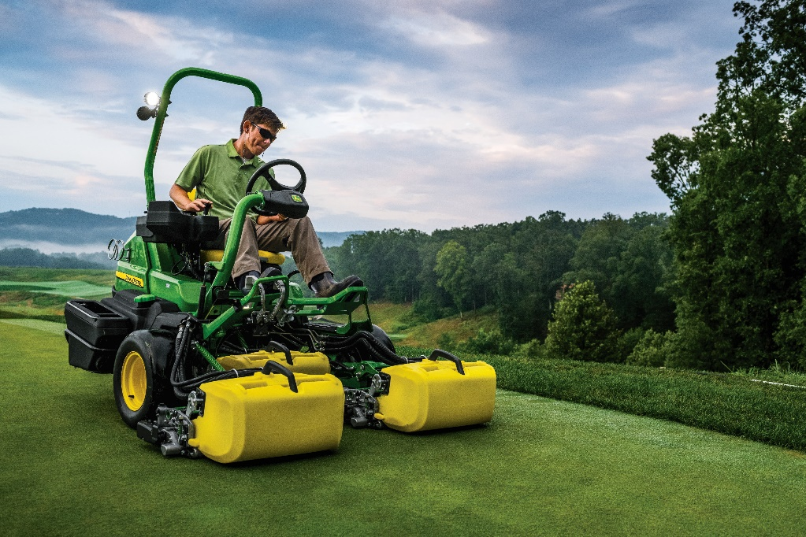
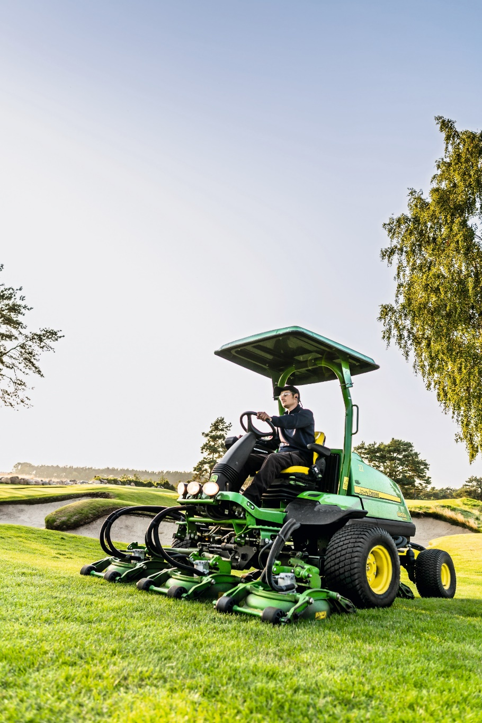
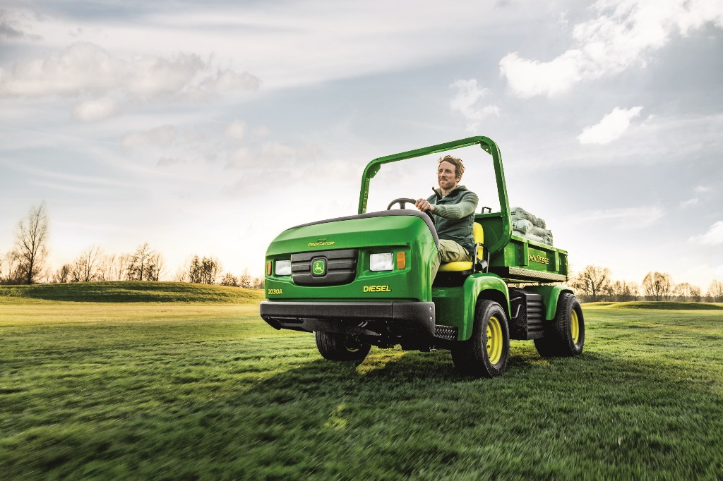
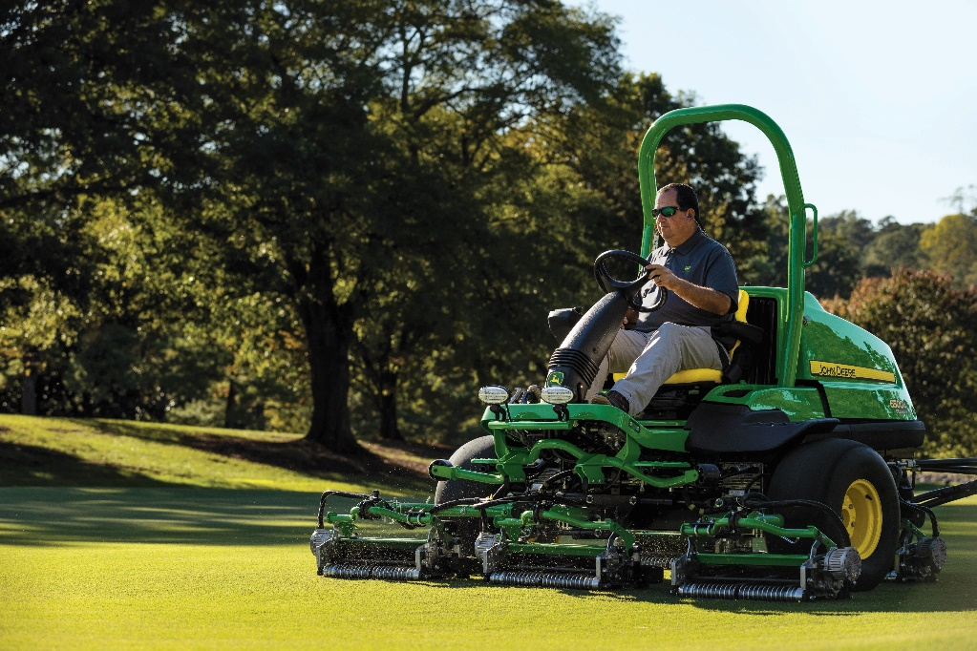
John Deere Turf Care
Golf and Sports Turf Mowing

Slide 12
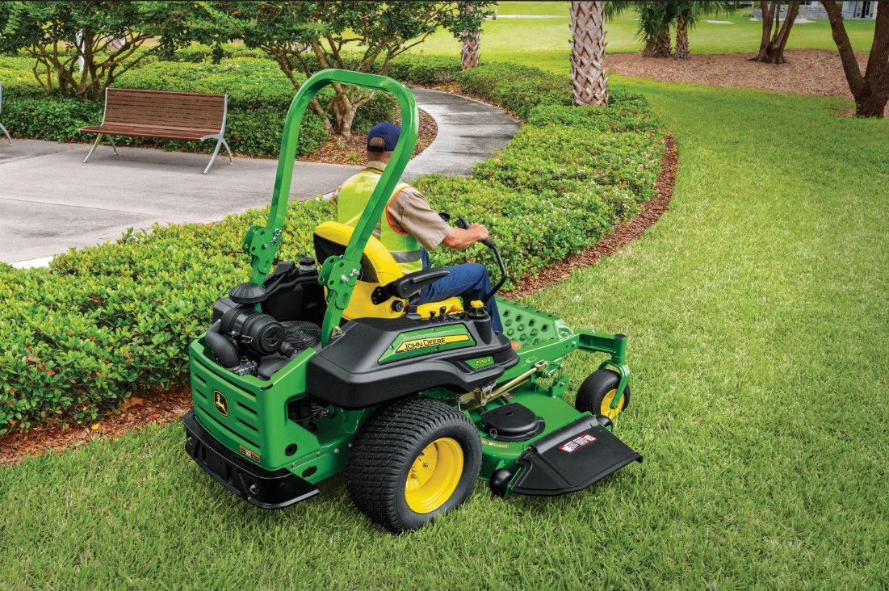
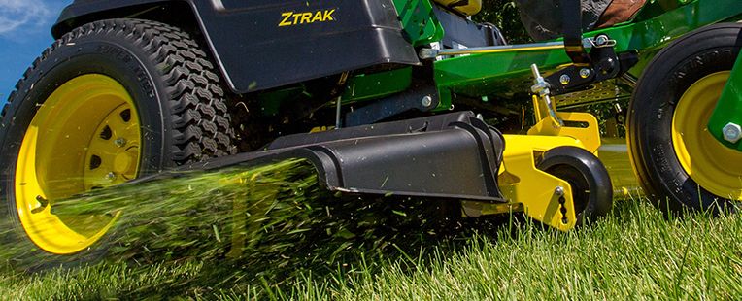
Machine Power
Air cooled gasoline engine
Industry standard for mowing
Provides power for mower deck and traction

Slide 13
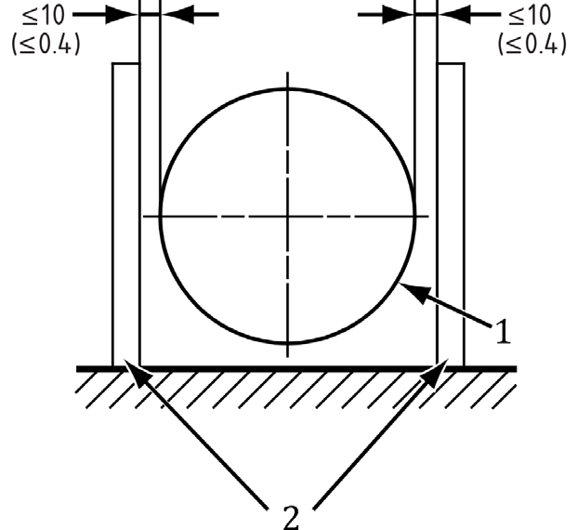
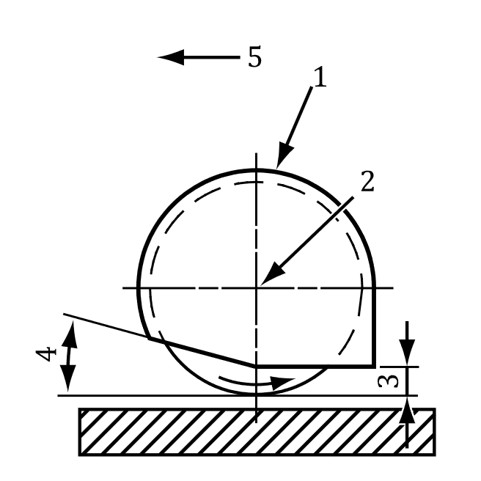
Safety & Compliance
Whole Body &
Hand/Arm Vibration​
Ensuring vibration does not exceed ergonomic criteria
Industry Standard that applies to mower: ANSI/OPEI 5395
Guarding
Moving parts must be checked to ensure safety, especially with throw line
Avoiding pinch points in added designs
Cutting Stop Time
Rotation stops within 6.7 seconds of engaging material dispersion system
Also applies to a separate fan for grass collection
Sound Quality
Maintain similar sound quality and avoid harsh or unexpected sounds.

Slide 14
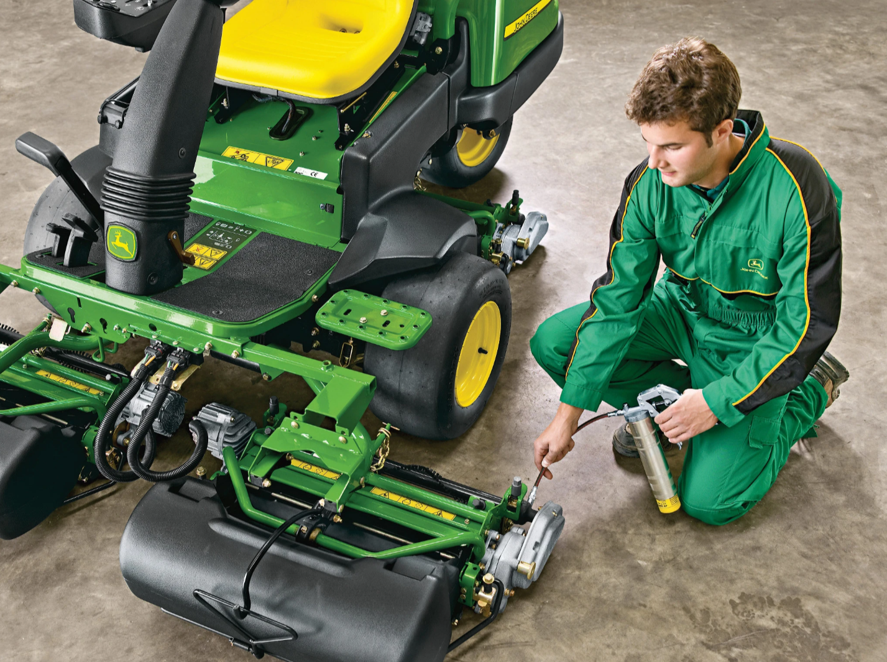
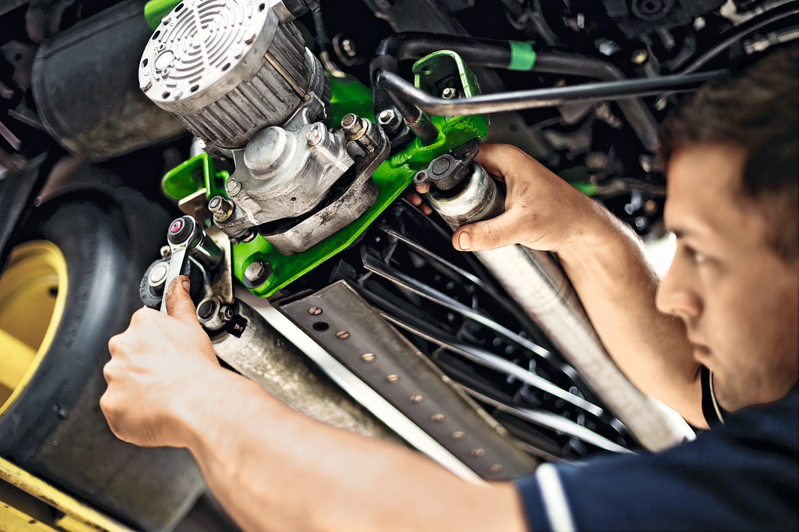
Problem Statement
Task/workflow disruption
    Emptying grass catchers requires a stop to the mowing task
    Unexpected/untimely catchers full can cause need to skip passes, transport, backtrack, etc.
Operator offload/ergonomics
    Operator must constantly monitor catcher fill, increasing mental load
    Repeated machine entry/exit is not ideal for ergonomics
    Some operators may struggle with the physical task of removing, emptying, and reinstalling catch baskets
    Takeaway
    Repetitive manual/visual catcher fill monitoring and material emptying/dispersion hinders smooth/continuous operation and increases mental and physical load on the operator.

Slide 15
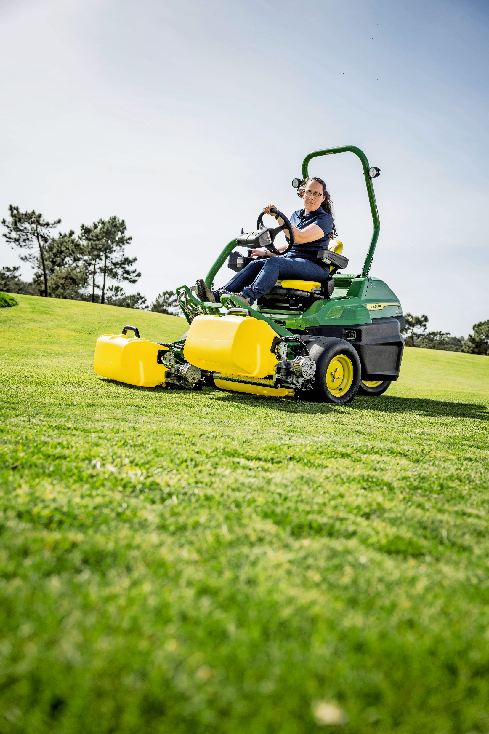
Proposal for Improvement
    Design a system to interface with existing grass catcher/cutting systems that will enable automatic fill monitoring and material emptying/dispersion, unlocking automated workflows, easier operation, and less mental and physical load on the operator.
    Electronic fill level monitoring
      Output fill level via analog voltage (0-12V) or J1939 messaging
    Electronic powered catcher emptying
      Remove as much material collected in catch basket as possible when commanded
    Agnostic to sensing solution (ultrasonic, strain, etc.)
    Design must not compromise the performance of the vehicle or cutting unit.
      Design may not impeded reel, yoke, or yoke arm movement
    Available power sources:
      12VDC rail
      58VDC rail
    Stretch goal:
      Design should disperse grass clippings evenly across an 8ft diameter area in front of the machine (rear cutting unit clipping dispersion may not be as even due to cutting unit location)

Slide 16
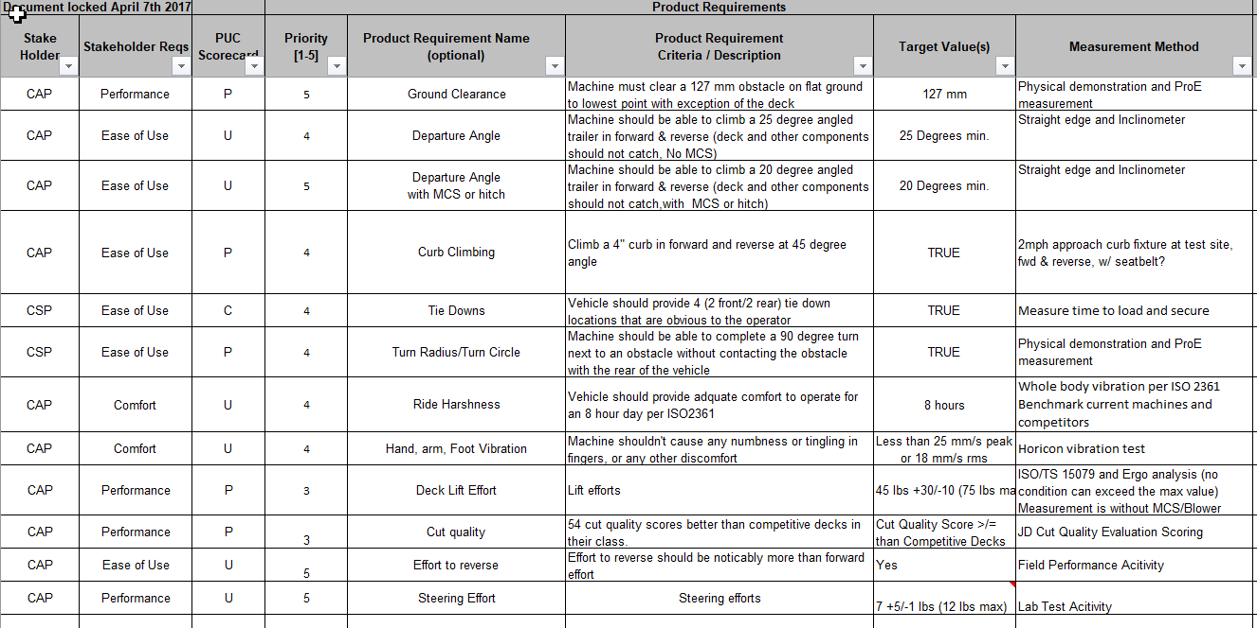
Evaluation Criteria
    Compliance with OPEI/ANSI 5395
    Characterizing the problem
    Value: Cost vs. Performance
    Operator impact
    Bystander impact
    Manufacturability
    Maintains current machine performance
    Maintains current vehicle architecture

Slide 17
Questions?

